Slide 1
Heart Attack Analysis
By: JinWei Loh, Tom Liu

Slide 2
About the Data
Age : Age of the patient
Sex : Sex of the patient
exang: exercise induced angina (1 = yes; 0 = no)
ca: number of major vessels (0-3)
cp : Chest Pain type chest pain type
Value 1: typical angina
Value 2: atypical angina
Value 3: non-anginal pain
Value 4: asymptomatic
trtbps : resting blood pressure (in mm Hg)

Slide 3
About the Data
chol : cholestoral in mg/dl fetched via BMI sensor
fbs : (fasting blood sugar > 120 mg/dl) (1 = true; 0 = false)
rest_ecg : resting electrocardiographic results
Value 0: normal
Value 1: having ST-T wave abnormality (T wave inversions and/or ST elevation or depression of > 0.05 mV)
Value 2: showing probable or definite left ventricular hypertrophy by Estes' criteria
thalach : maximum heart rate achieved
target : 0= less chance of heart attack 1= more chance of heart attack

Slide 4
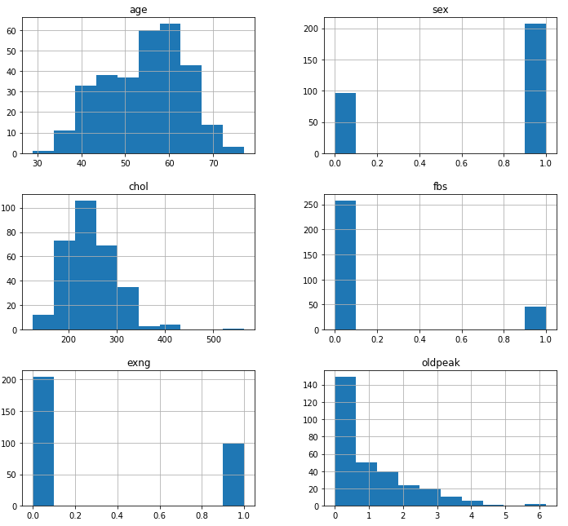
About the Data

Slide 5
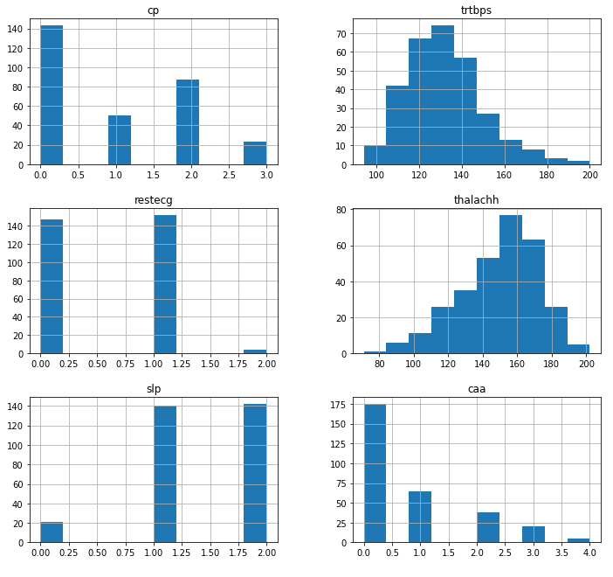
About the Data

Slide 6
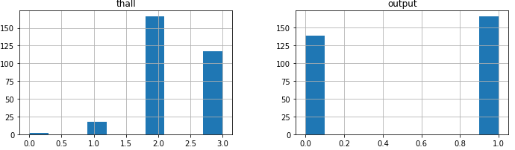
About the Data

Slide 7
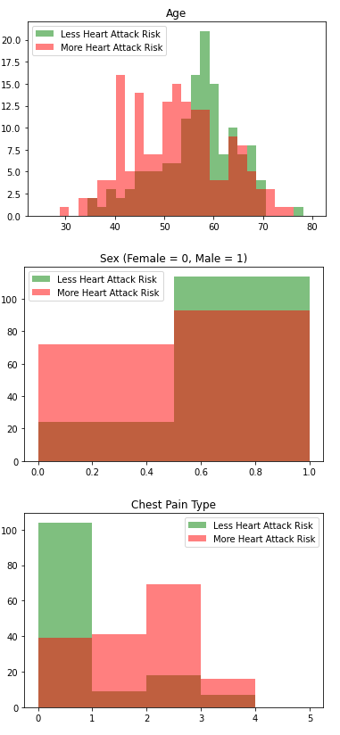
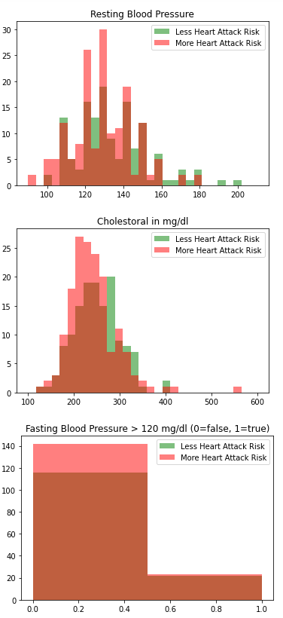
Correlation to Output

Slide 8
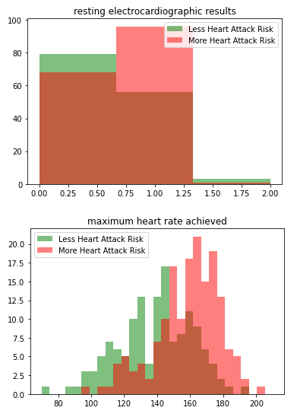
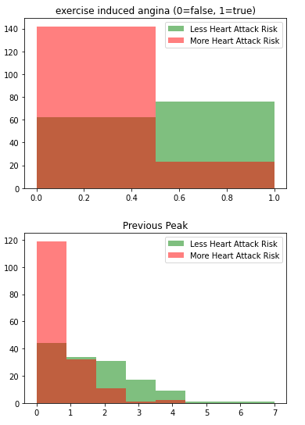
Correlation to Output

Slide 9
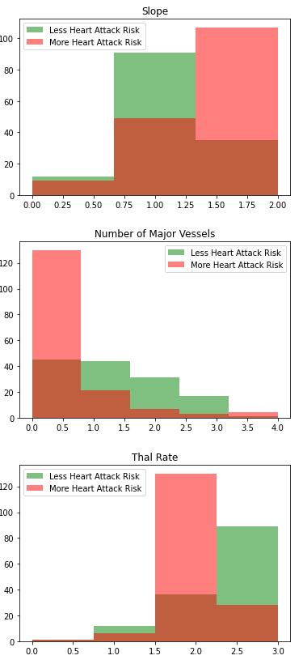
Correlation to Output

Slide 10
Supervised Analysis

Slide 11
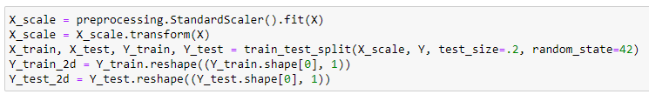
Preprocessing
Normalizing features and splitting them into training and validation sets with 8 to 2 training to validation ratio.
Lists to hold accuracies of each of the three models

Slide 12
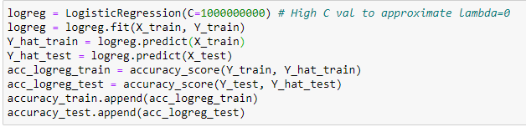
Linear Logistic Regression

Slide 13
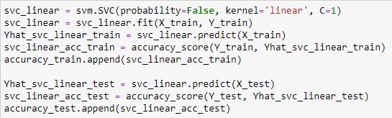
SVM

Slide 14
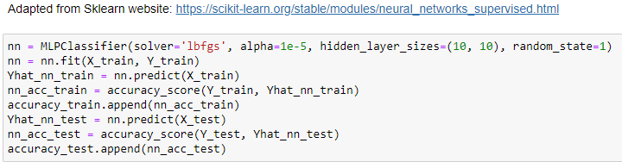
Neural Networks

Slide 15
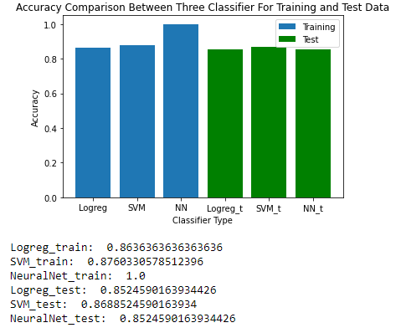
Accuracies
With no feature transformation and no regularizations, we observe that SVM scored highest accuracy. It is worth pointing out that NN scored perfect on training set but lower on the validation set. This is due the lack of regularization and thus results in an over-fit.

Slide 16
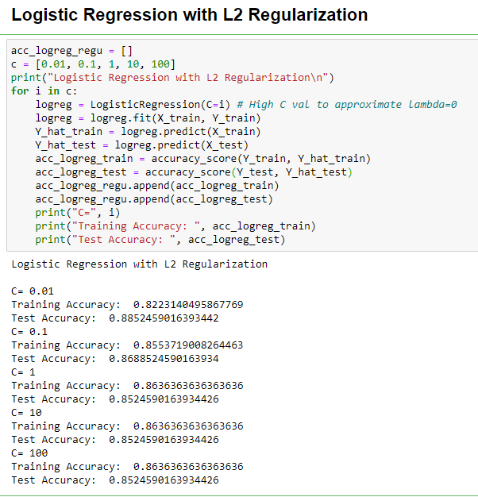
Logistic Regression with L2 Regularization
Adding L2 Regularization to simple linear logreg, we see a substantial increase in the test accuracy with C = 0.01 (higher lambda). As C increases, training accuracy increases but test accuracy takes a hit, since a higher C means less regularization, thus less penalty was put on big weights.

Slide 17
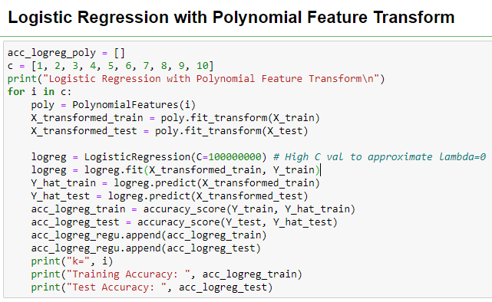
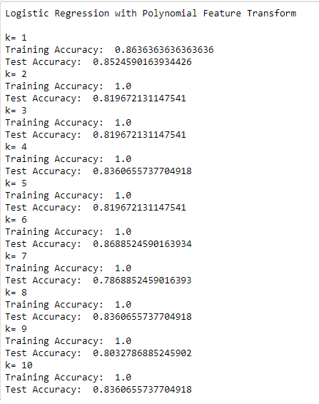
Logistic Regression with Poly Feature Transform
Using polynomial feature transformation, we see that the test accuracy peaks at k=6, suggesting that the model neither under-fits nor over-fits.

Slide 18
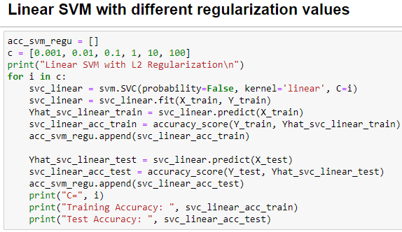
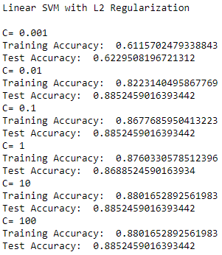
Linear Kernel SVM with Regularization
When C=0.001, lambda is highest out of all C's, but accuracy is lowest, essentially making it more of a hard margin SVM. This suggest that perhaps Linear SVM may not be sufficient to properly classify the points. Here it seems that C=0.01 would have the highest levels of regularization without sacrificing test accuracy.

Slide 19
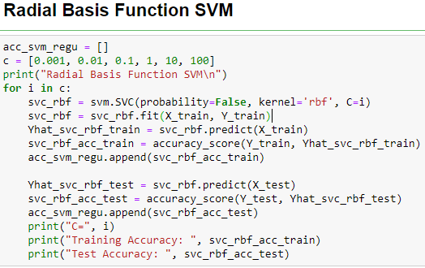
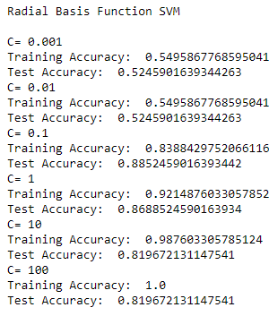
RBF SVM
Notice that the test accuracy is the highest and the same for RBF and Linear kernel at C = 0.1, suggesting that the data is not fit for using the RBF kernel.

Slide 20
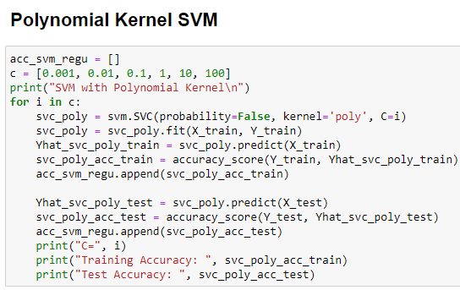
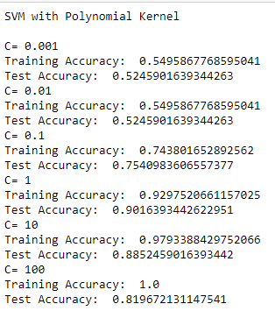
Polynomial Kernel SVM
Using polynomial kernel, we are able to achieve a 90% accuracy with C = 1. This is better than all of the models we have tested so far, suggesting that the model could potentially be polynomial separated.

Slide 21
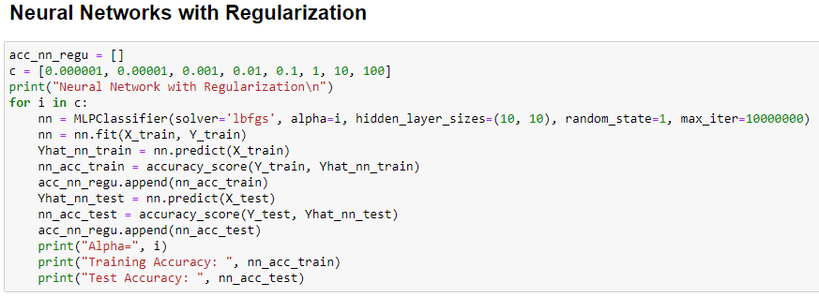
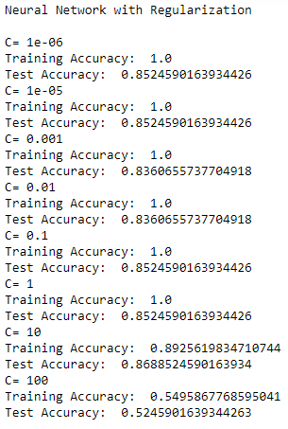
Neural Networks with Regularization
Using regularization, we could realize an improvement of accuracy at C = 10, from 85.246% to 86.885%

Slide 22
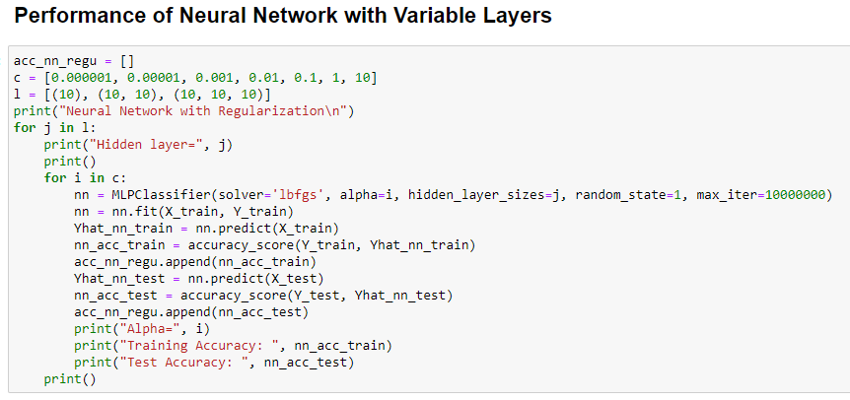
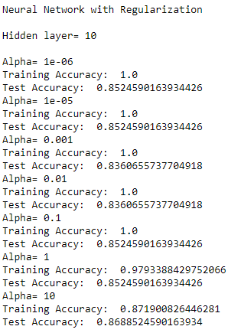
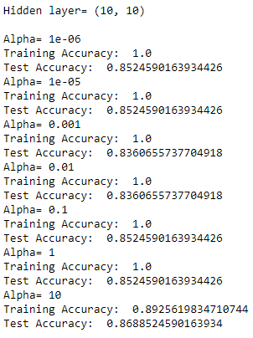
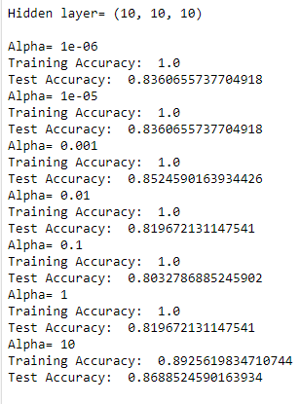
Neural Networks with Varying Layers

Slide 23
Neural Networks with Varying Layers
Adding more layers does not seems to improve the performance of the model, as previously tested that the data is most likely not separated by a flexible model.

Slide 24
Resuls

Slide 25
Results

Slide 26
Resources
https://scikit-learn.org/stable/modules/neural_networks_supervised.html

